Slide 1
Women and Work
An Analysis of Factors Affecting Female Labor Supply in 1975
Group 4
Yunjia Xie
Zhi Zeng
Jaemin Kim
Roshen Samuel

Slide 2
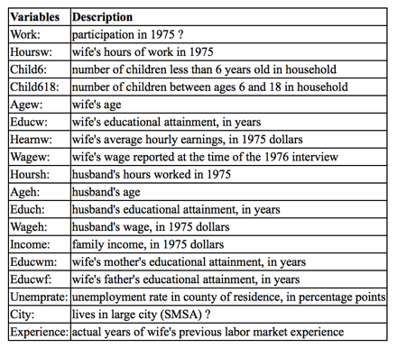
Introduction of our dataset

Slide 3
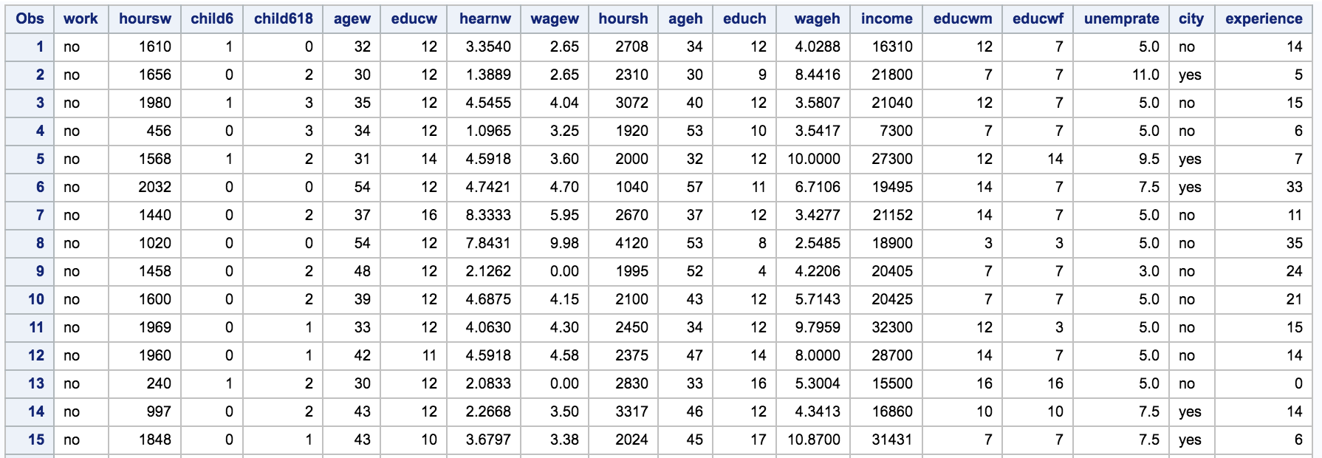
Initial View of our dataset*
*This shows the first 15 observations

Slide 4
Analysis Techniques
Yunjia: Use logistic regression to find whether women joined in labor force in 1975 based on give predictors. Mostly interested in the association between educational attainment and work status.
Jaemin: Perform PCA to investigate the significance and correlation between the variables, and use the correlation matrix, eigenvalues, and eigenvector table to find the optimal PCs, which will then be used to find relationships in our model.
Roshen: Use multiple linear regression to find whether the predictors relating to the women’s husband and children had an impact on the amount of hours she worked.
Zhi: to determine a function based on other variables to classify Work groups by applying discriminant analysis.

Slide 5
Multiple Linear Regression
Roshen Samuel

Slide 6
Introduction of Model
In today’s society, the amount of variables in a mother/wife’s family often affect how much of time a wife/mother is working versus how much time she is able to dedicate for her family.
The purpose of this analysis is to see how much of an impact does a husband and having children along with their specific traits have on the amount of hours the woman works? Specifically,
What variables relating to children and the husband are most important when examining the amount of hours the wife worked in a year?
How much of an impact did the important childrens variable have?
How much of an impact did the important husband variables have?
Is there any relation to the husband’s education level and the amount of hours the wife worked?

Slide 7
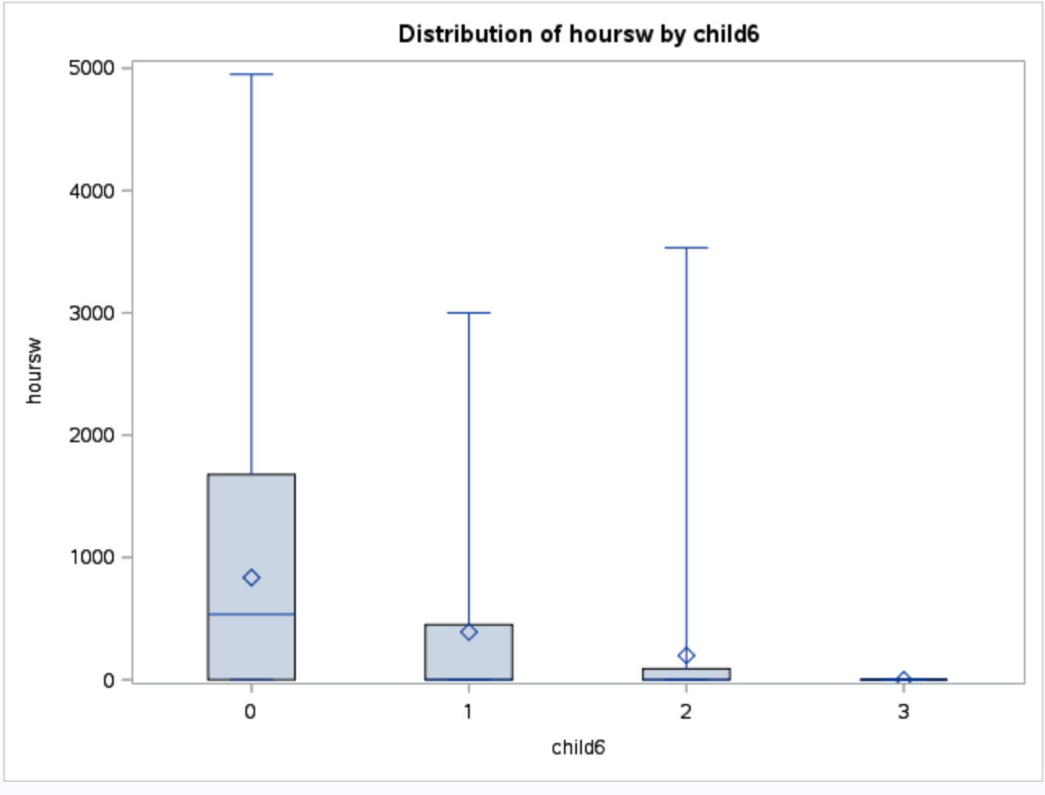
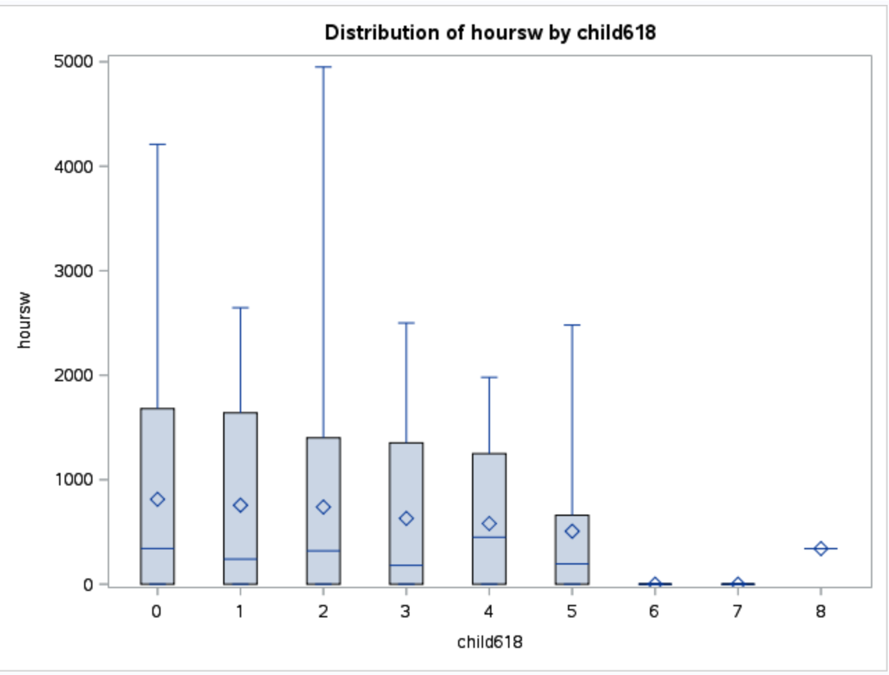
Boxplots of variables - Children

Slide 8
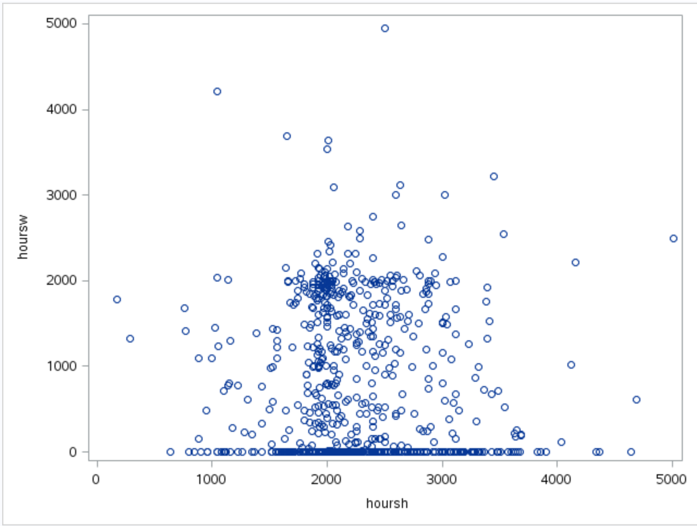
Scatterplots of Variables - Husband’s Work Hours
There is no obvious correlation between number of hours worked by the wife and the numbers of hours worked by the husband.
However, we can see that there are a lot of observations in which the wife did not (or barely) worked in 1975.

Slide 9
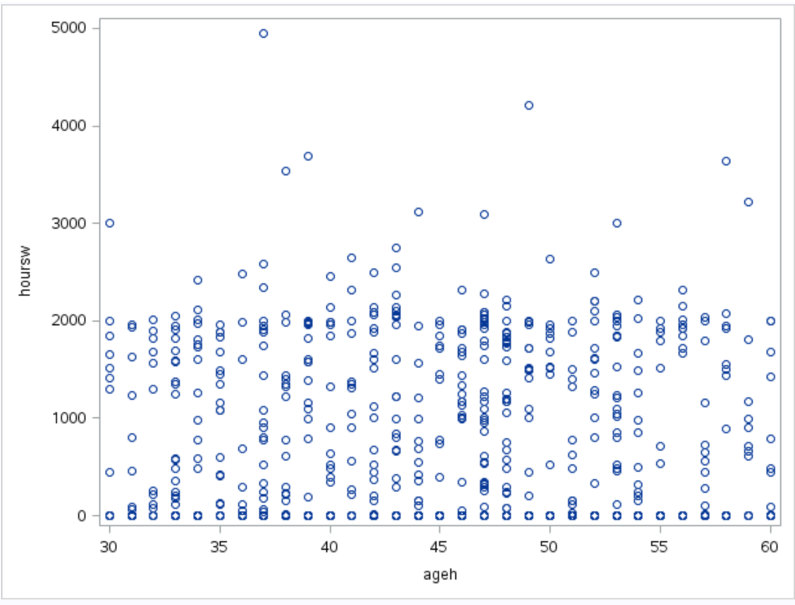
Plots of variables - Age of Husband
The wife’s work hours is not solely dependent on the husband’s age (regardless of the husband’s age, the wife’s work hours do not really change).

Slide 10
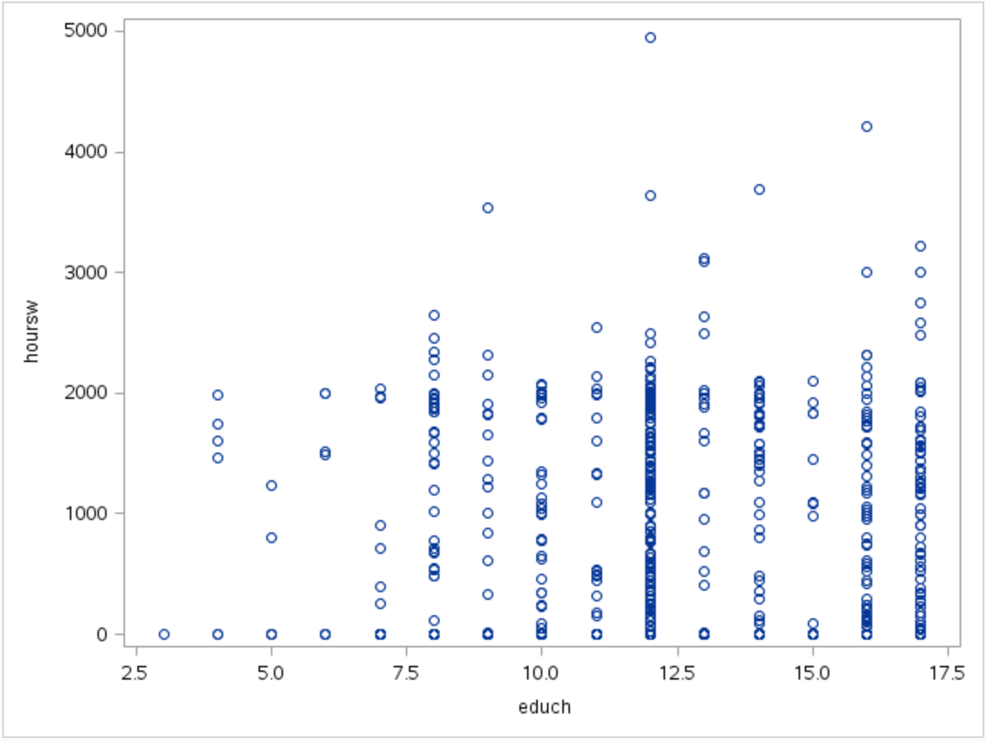
Plots of variables - Husband’s Education Level
As the husband’s level of education increased, the wife’s work hours also increased.

Slide 11
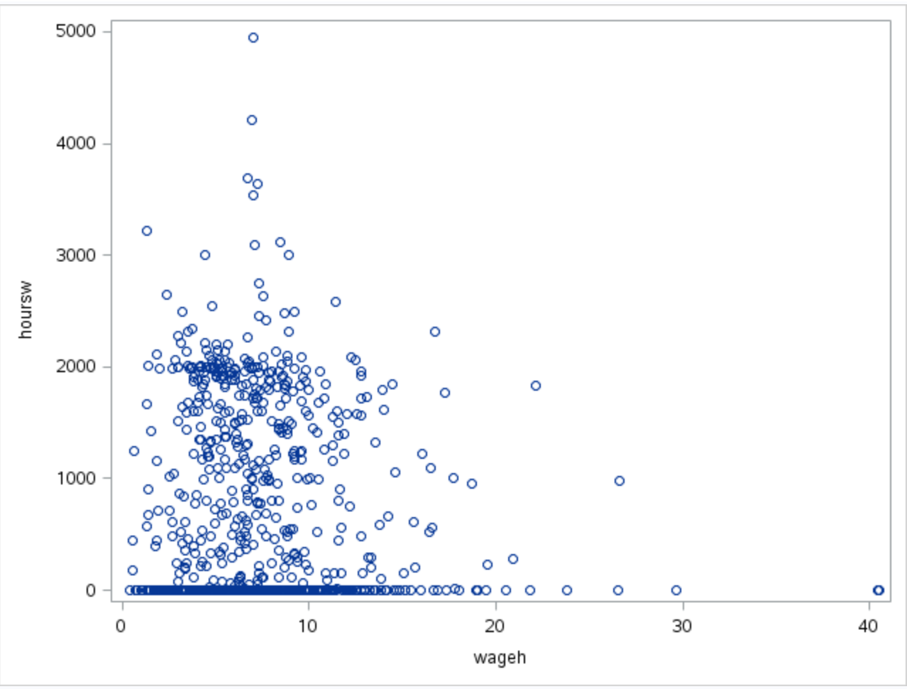
Plots of variables - Husband’s Hourly Wage
As the husband’s hourly wage increased, the wife’s work hours decreased.

Slide 12
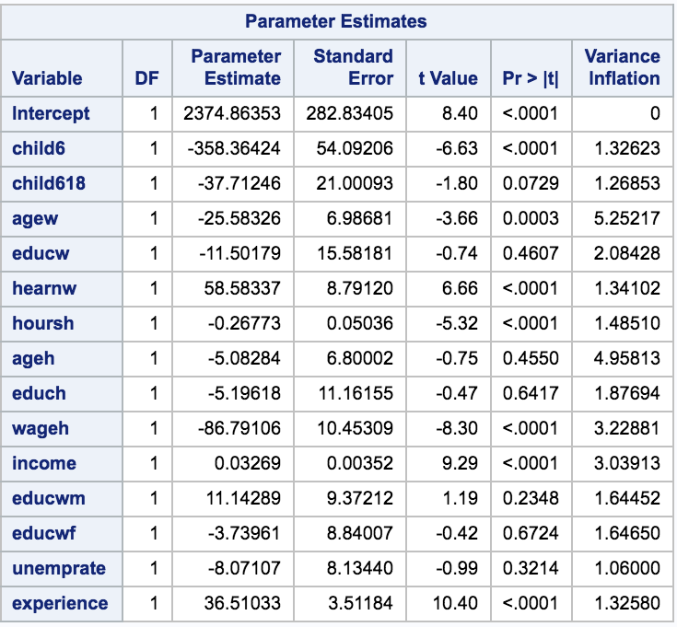
Initial Model
Initial model with the wife’s number of work hours as the response variable.
Even though there is no VIF that is greater than 10(highest VIF value is approximately 5.25), we can see that the model contains a few variables that have a p-value that is greater than .05, which indicates that we should remove these variables.

Slide 13
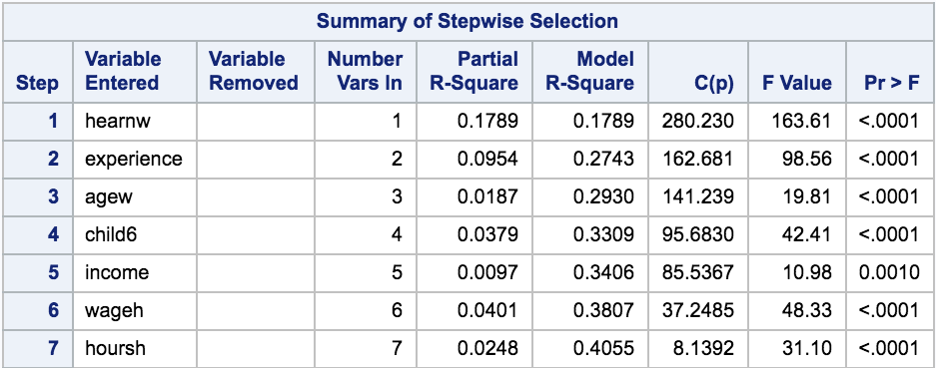
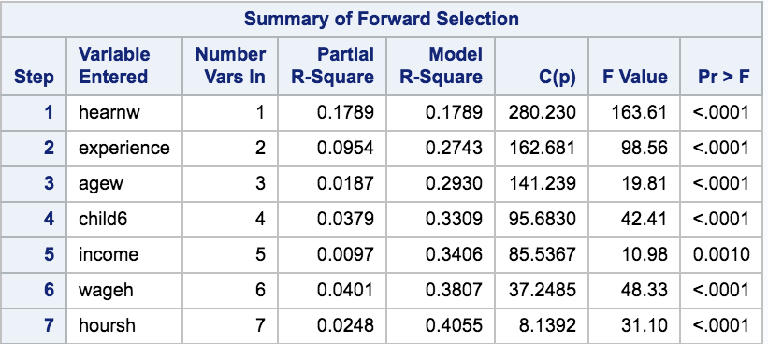
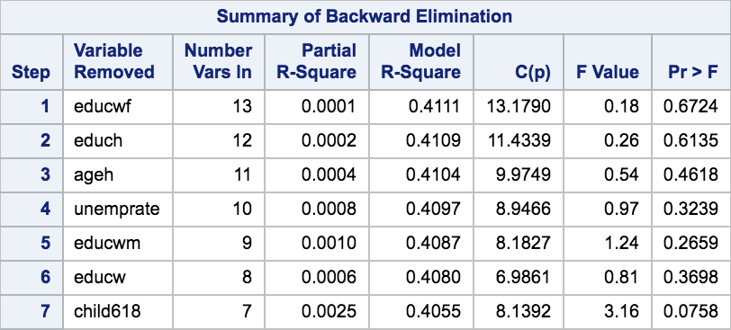
Variable Selection
Stepwise, forward, and backward selection all led to the same conclusion - the variables that should be kept in the model are: hearnw, experience, agew, child6, income, wageh, and hoursh

Slide 14
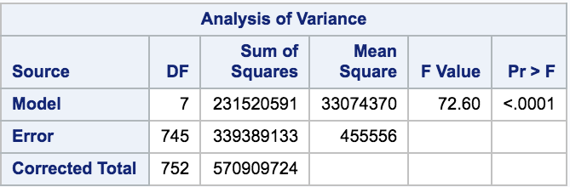
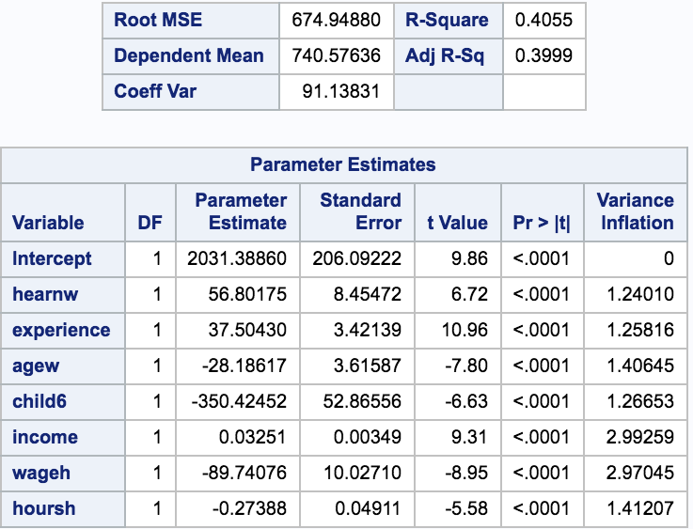
After the amount of variables were narrowed down, we can see the following:
Since the p-value of the f-test is less than .05, we can reject the null hypothesis that the variables have equal means
Adjusted R^2 is .39999
The only variables relating to the husband and children left in the model are child6, wageh and hoursh.

Slide 15
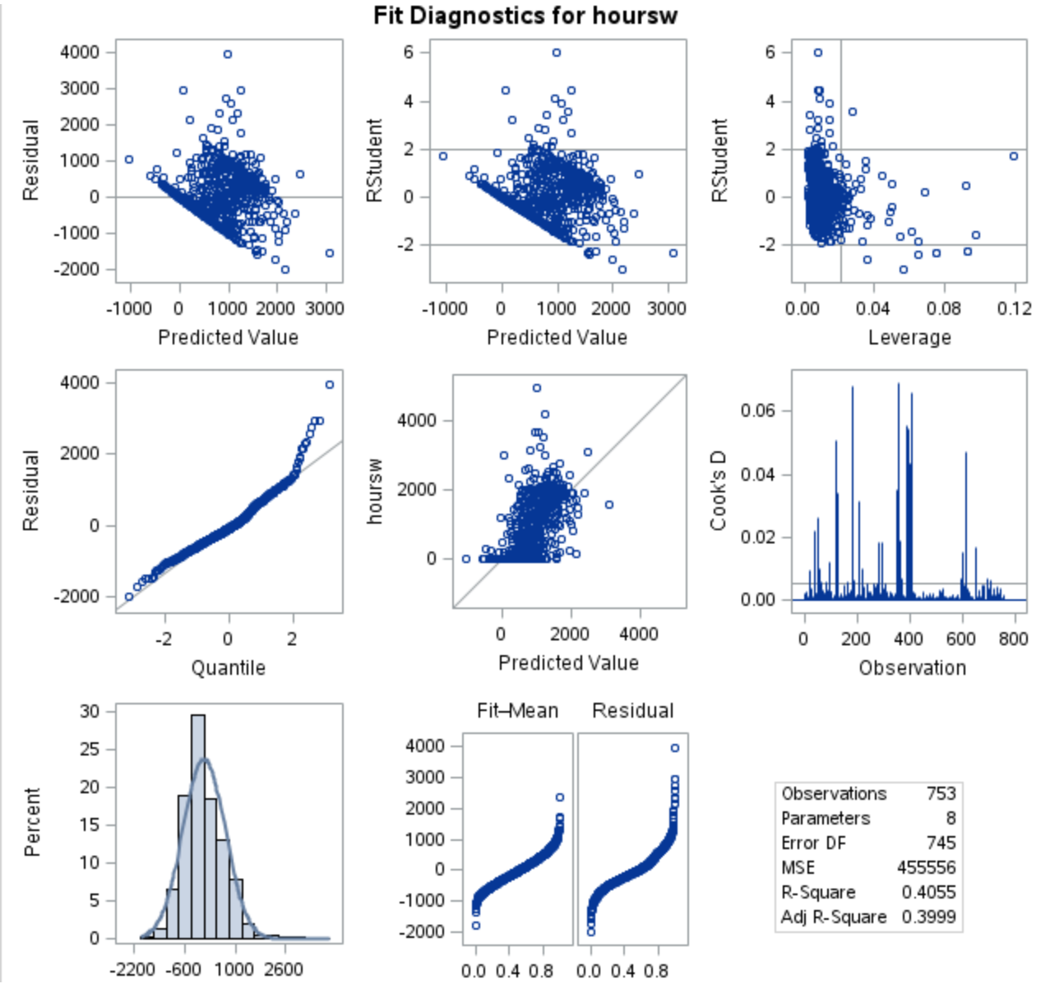
Diagnostics
We can see from the diagnostic plots that there are no observations that have a Cook’s Distance that are greater than 1, and the data from the plots as a whole appears to be normal.

Slide 16
Conclusion
What variables relating to children and the husband are most important when examining the amount of hours the wife worked in a year?
The remaining variables were wageh, hoursh, and child6.
How much of an impact did the important childrens variable have?
For every 1 unit increase in child6, this would decrease the amount of hours worked by the wife by about 350 hours.
How much of an impact did the important husband variables have?
For every 1 unit increase in wageh, this would decrease the amount of hours worked by the wife by nearly 90 hours.
For every 1 unit increase in hoursh, this would decrease the amount of hours worked by the wife by nearly .28 hours.
Is there any relation to the husband’s education level and the amount of hours the wife worked?
From our reduced model, we can see that the husband’s educational level has no significant impact on the amount of hours the wife worked.

Slide 17
Logistic Regression by Yunjia (Leah)
Did women’s working status strongly depend on their educational attainment?
Does husbands’ educational attainment influenced wives’ work status?
Was women who born in an academically dominated family likely to engage in a labor force?
Besides educational indicators, what predictors are significant in logistic regression?

Slide 18
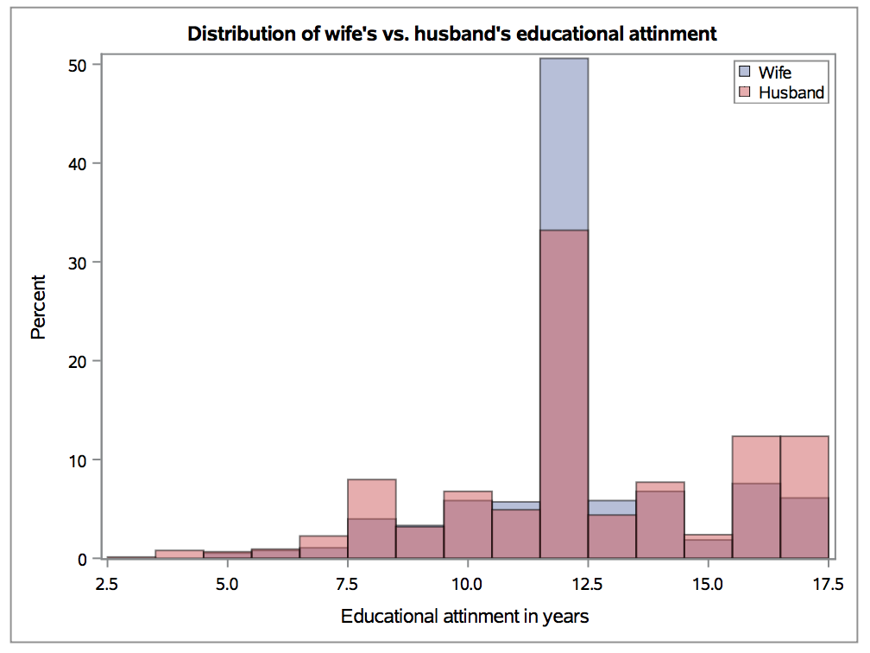
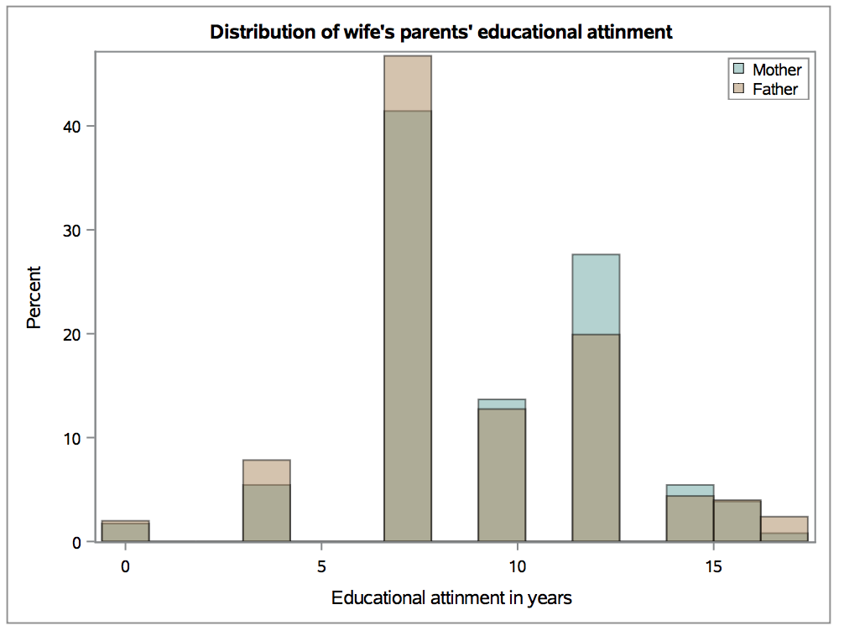
Interesting Facts

Slide 19
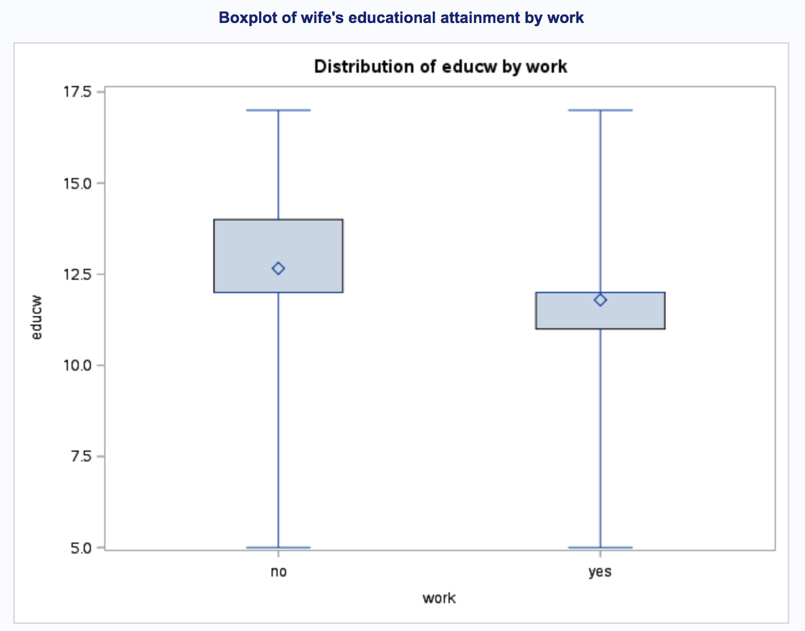
The boxplot of wife’s educational attainment by works shows that women who did have a job in 1975 had only medium educational attainment. But those who did not have a job are more educated, which might be contrary to our contemporary perception.

Slide 20
Education Attainment Level (in years)
Less than 9 years: education level = 1
Between 9 years and 12 years: education level =2
Greater than 12 years: education level = 3

Slide 21
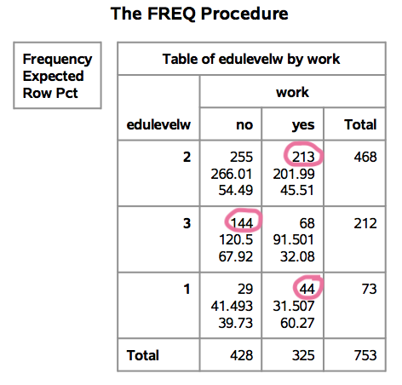
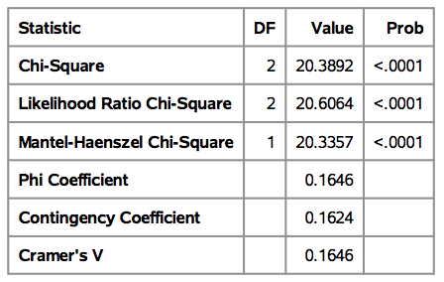
Frequency table of wife’s educational attainment vs. work
Pearson’s Chi-Square
Likelihood Ratio Chi-Square
Mantel-Haenszel: linear trend
significant association

Slide 22
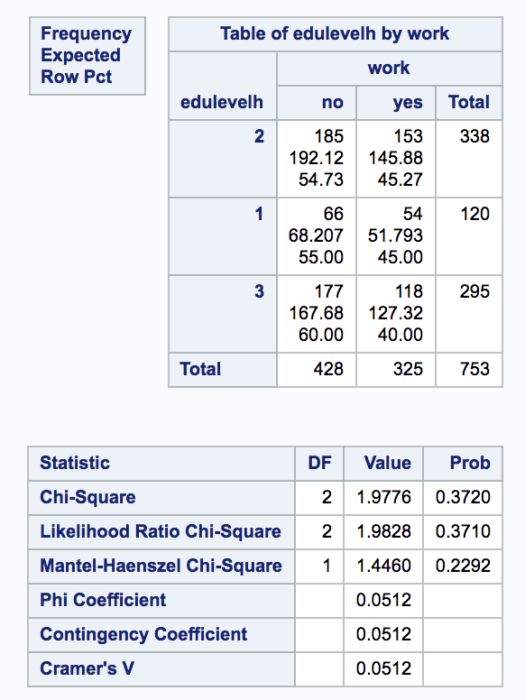
Frequency table of husband’s educational attainment vs. work
The p-value for Pearson’s Chi-Square, Likelihood Ratio Chi-Square and Mantel-Haenszel Test are insignificant.
There is NO statistically significant association between husband’s educational attainment and wife’s working status.

Slide 23
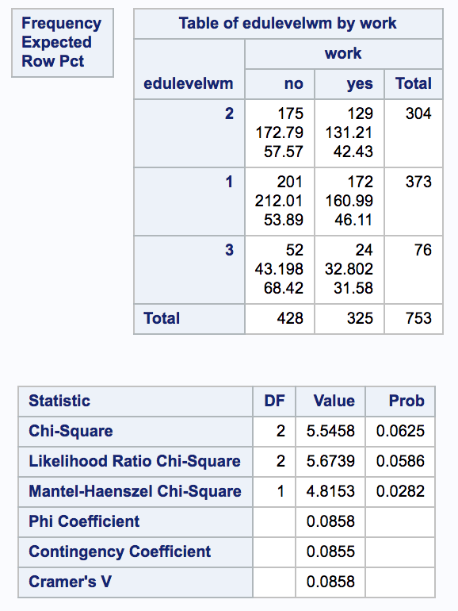
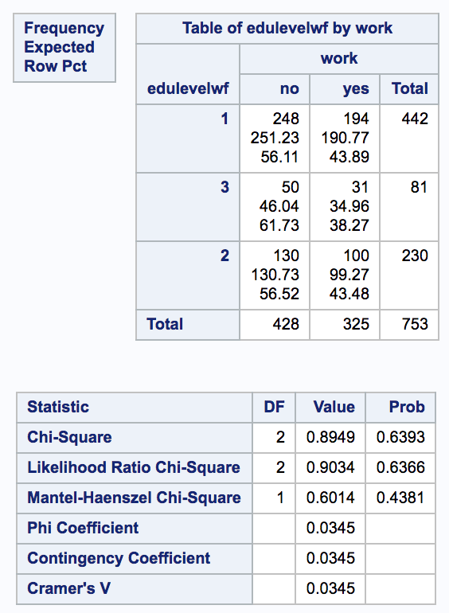
Frequency table of parents’ educational attainment vs. work
No association...

Slide 24
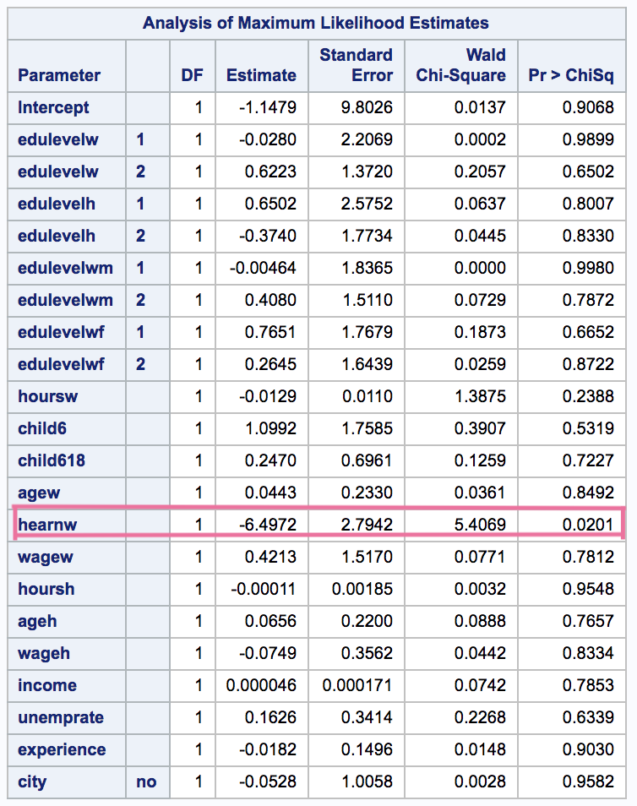
First glance of logistic regression result
Only hearnw (wife's average hourly earnings, in 1975 dollars) has p-value < 0.05, which is significant in this model

Slide 25
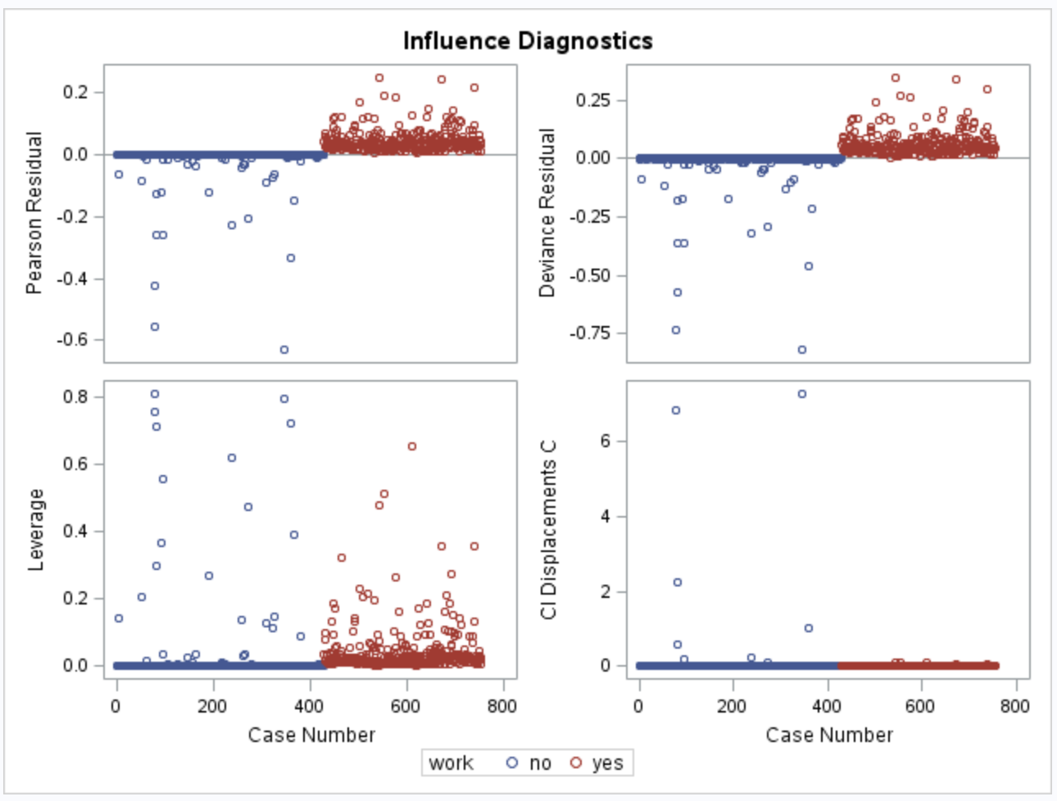
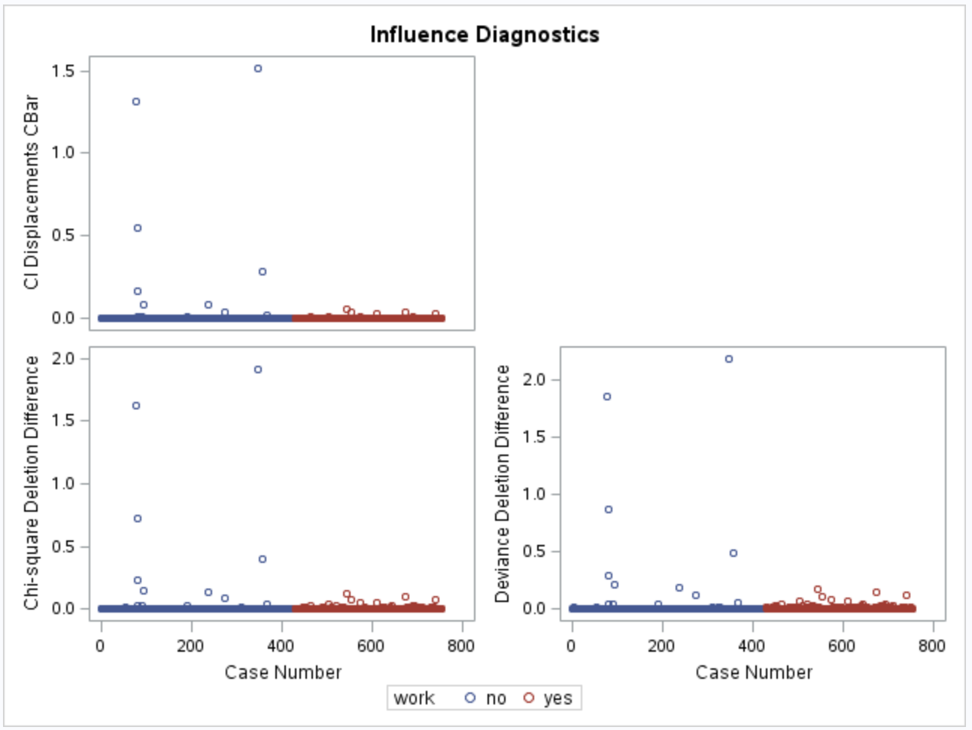
Influence Diagnostics

Slide 26
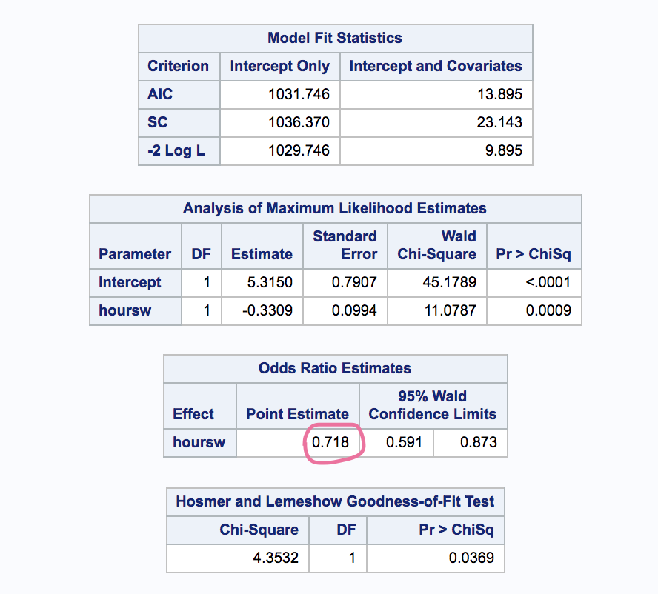
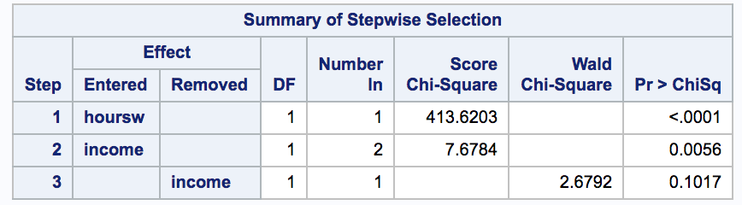
Stepwise Selection
s
Hoursw (wife's hours of work, in 1975 dollars) is significant in this model
The odds ratio estimates of wife’s avg. hourly earnings is 0.718
Hosmer and Lemeshow test: lack of fit issue

Slide 27
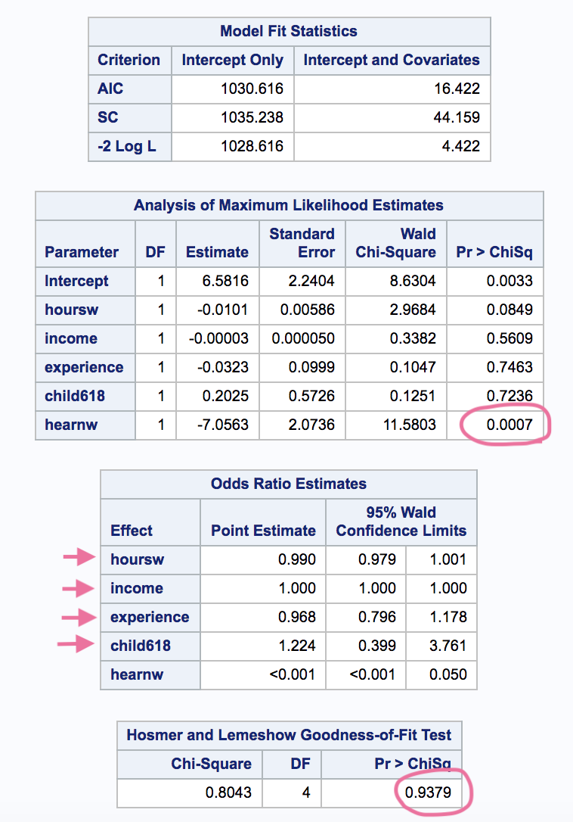
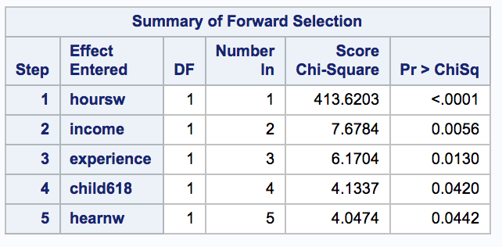
Forward Selection
Hearnw (wife's average hourly earnings, in 1975 dollars) is significant
Only the odds ratio for hearnw is significant
Hosmer and Lemeshow: model is good of fit

Slide 28
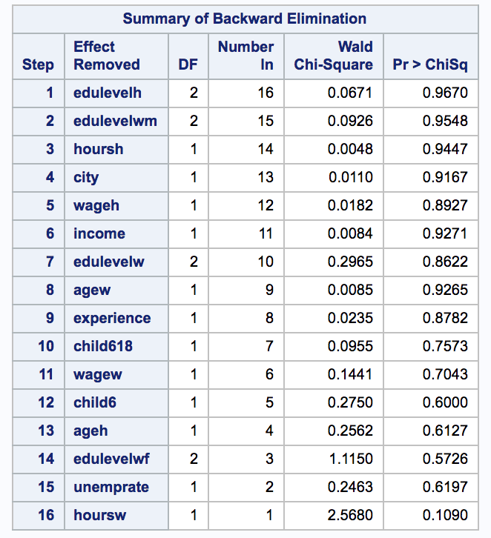
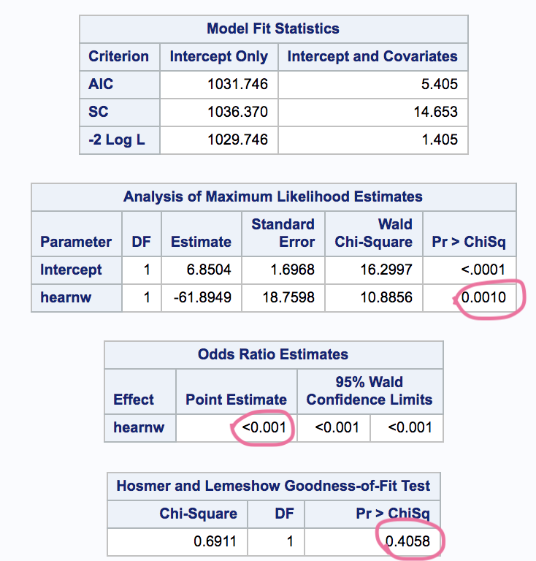
Backward Selection
Only hearnw left
Hearnw is significant
Odds ratio for hearnw is <0.001 and 95% CI does not contain 1
Hosmer and Lemeshow test: model is good of fit

Slide 29
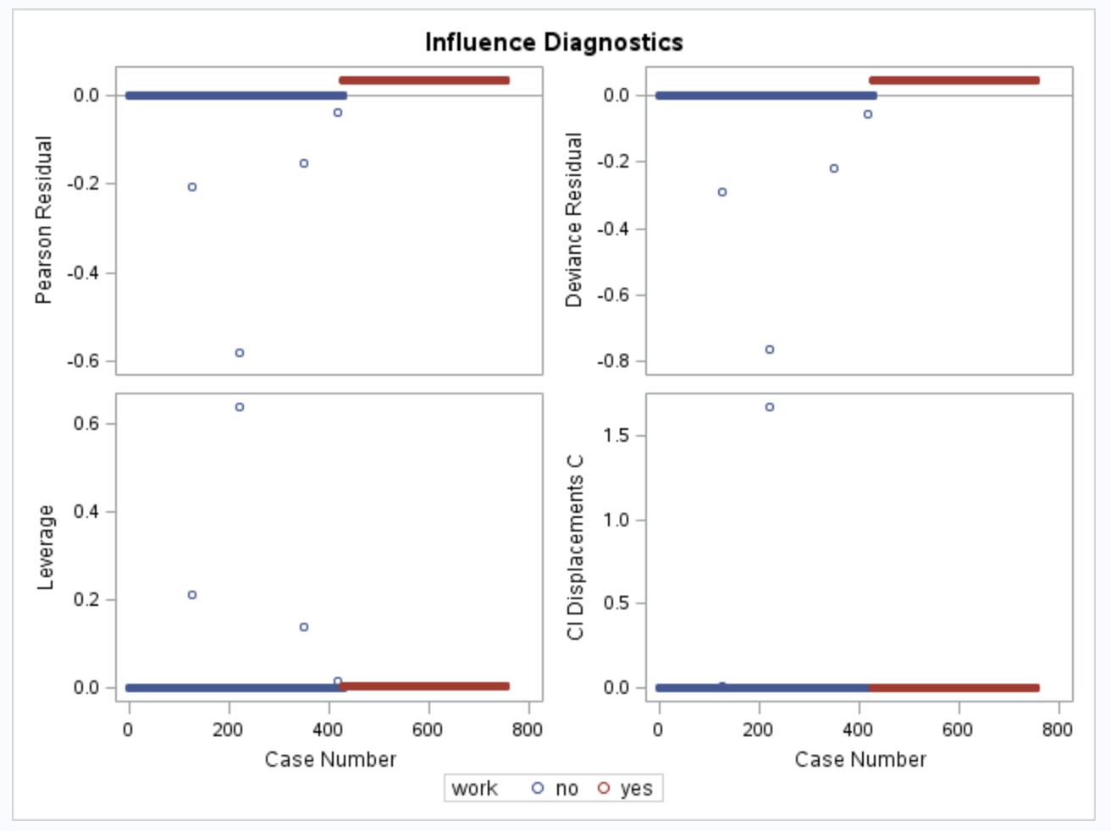
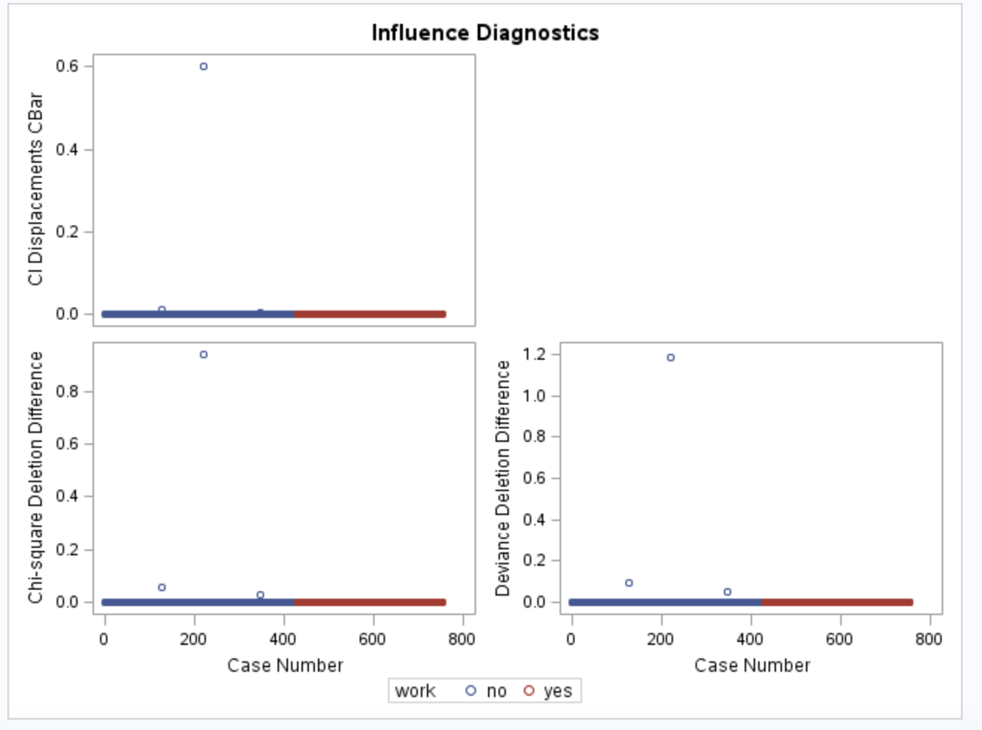
Refit a new model with backward selection

Slide 30
Back to previous questions… (Conclusion)
Q: Did women’s work status strongly depend on their educational attainment?
A: Not too much, but some hints suggest women with low educational attainment are more likely to engage in labor force.
Q: Does husbands’ educational attainment influenced wives’ work status?
A: No significant association.

Slide 31
Q: Was women who born in an academically dominated family likely to engage in a labor force?
A: No. Family does not affect women’s decision to work in 1975.
Q: Besides educational indicators, what predictors are significant in logistic regression?
A: Considering the result of three model selection method, I decided to use backward selection. Wife’s average hourly earnings seems to be a influential factor.

Slide 32
Principal Component Analysis(PCA)
...And little cluster analysis
How many PCs should we decide to use?
Is there any relationship found from comparing work conditions between wives and husbands?
Is there any relationship among PCs?
Jaemin Kim

Slide 33
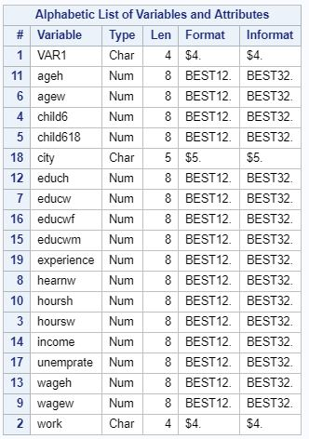
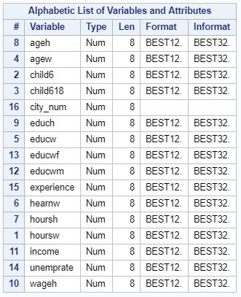
Data Cleaning
PROC CONTENTS
city_num = input(city, best12.);

Slide 34
Simple Statistics
Simple Statistics give you a rough comparison between husband and wife.
Wife’s Hours of Work: 741 Wife’s average hourly earning: 2.37
Husband’s Hours of Work: 2267 Husband’s average earning: 7.48

Slide 35
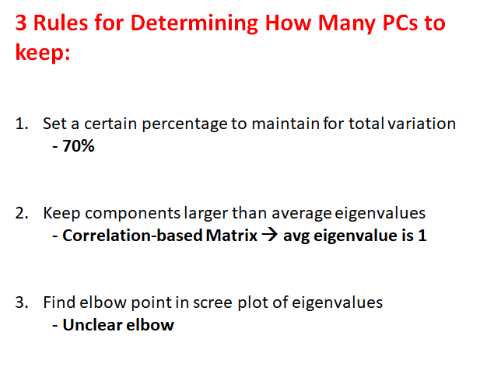
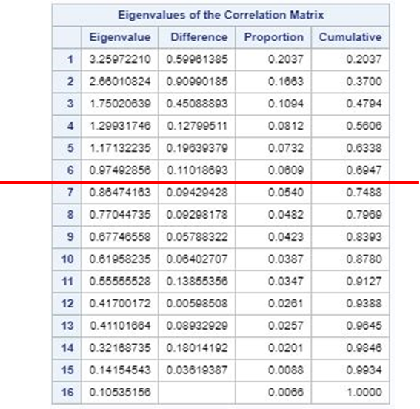
Correlation Matrix

Slide 36
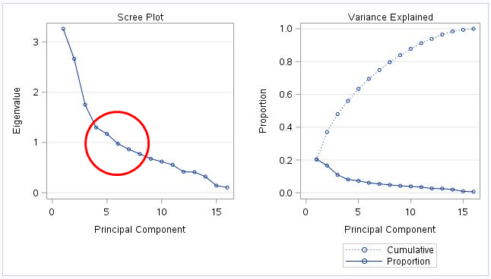
Scree Plot for Eigenvalue
Even though the elbow in our scree plot is not clear, we will use 6PCs to perform further analysis.

Slide 37
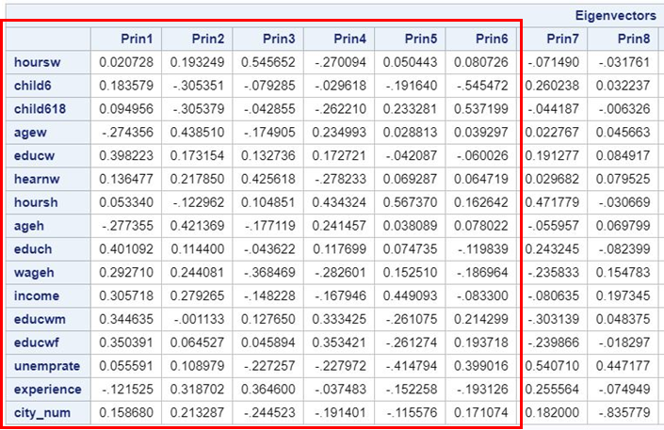
Eigenvectors Table

Slide 38
Eigenvectors Table
PC1: Educational attainment for both W&H⬆️
Age of W&H , job experience ⬇️
PC2: Age of W&H, job experience ⬆️
Child rate ⬇️
PC6: Child 6-18, Unemprate
Edu.of W&H, Child -6
PC3: W working hour, W wage, ⬆️
Child rate, Age of W&H, Income ⬇️
PC4: Age of W&H, Edu.of W’s M&F ⬆️
Child rate, W working hour ⬇️
PC5: H working hour, Income ⬆️
Edu.of W’s M&F, W edu.⬇️

Slide 39
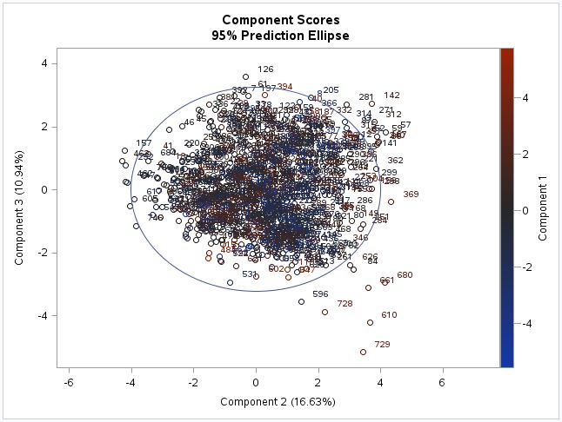
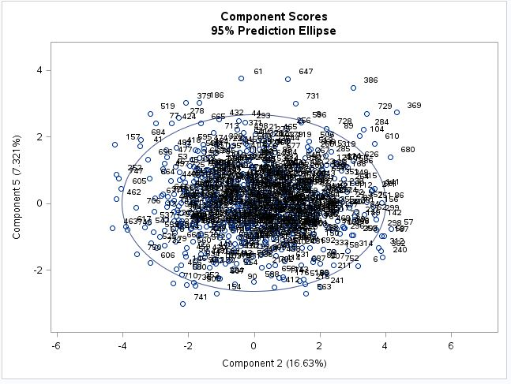
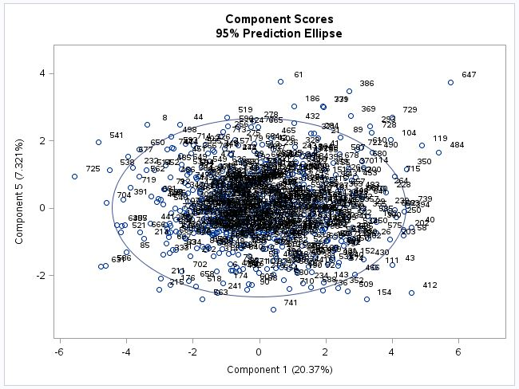
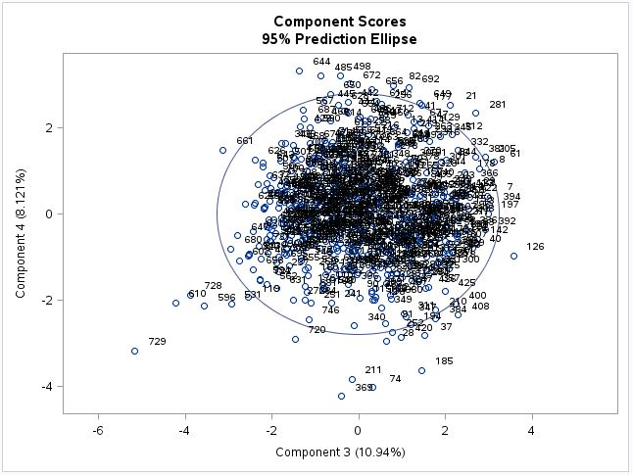
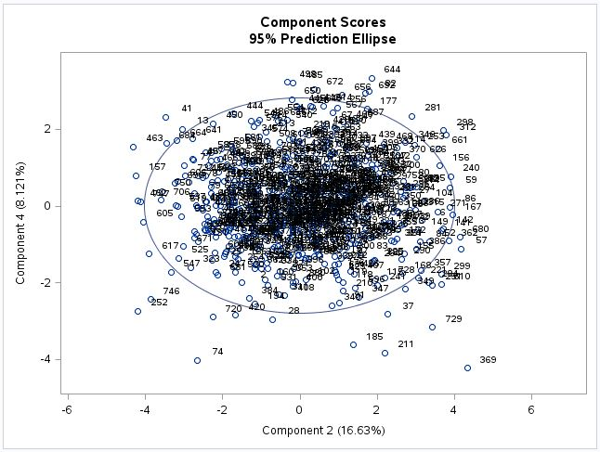
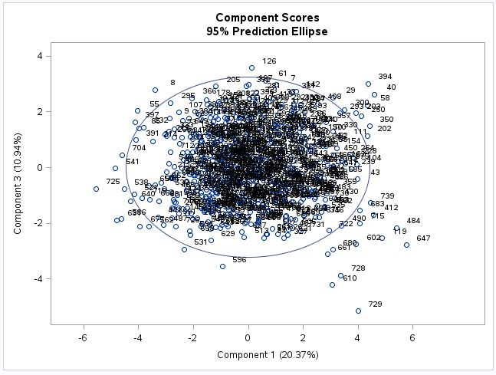
Score Plots for ncomp=6

Slide 40
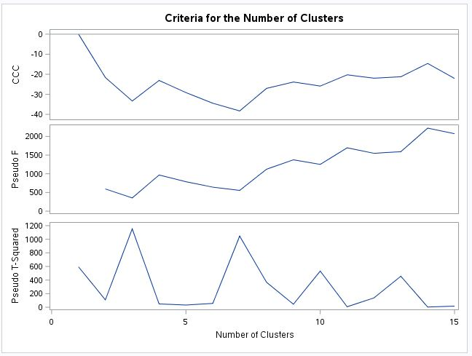
CCC, Pseudo F, Pseudo T-Squared Tests
•All values of the CCC are negative •Decreasing for two or more clusters
= the distribution is probably unimodal or long-tailed
-Warren Sarle

Slide 41
Conclusion
Through several methods in determining the optimal PCs to use, we were left with 6 Principal Components
Various relationships were found after performing PCA when comparing the variables to themselves and to PCs 1-6.
Score Plots did not indicate any special point, outlier, or trend/pattern in the plots.
Could not perform cluster analysis because the range of CCC plot was all negative.

Slide 42
Discriminant Analysis
by Zhi Zeng

Slide 43
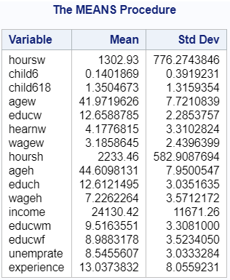
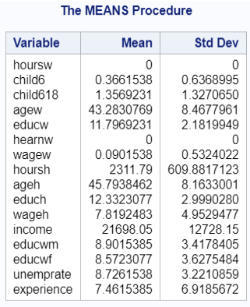
Discriminant Analysis
wife's hours of work in 1975
wife's average hourly earnings
wife's wage reported

Slide 44
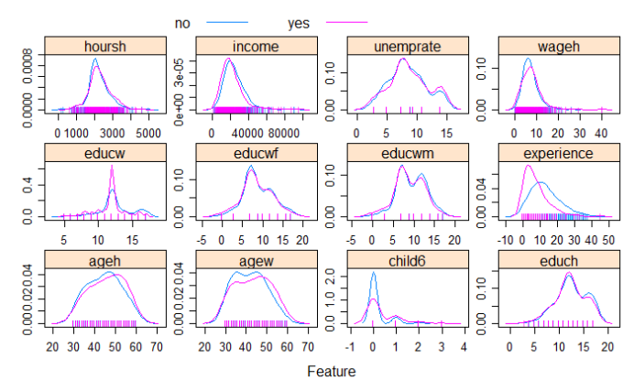
Density Plots

Slide 45

Initial Discriminant Analysis Model
The p-value for the test of homogeneity of within covariance is less than 0.0001.
The covariance matrix is not identical.

Slide 46

The MANOVA tests show p-values less than 0.0001, thus we can conclude that there are significant differences in some characteristics between the two levels of work.

Slide 47

The cross-validation estimated overall error is 0.2922 based on proportional-prior discriminant analysis, thus the accuracy is about 0.7078.

Slide 48

Stepwise Variable Selection

Slide 49

Variable Selected Model for Work
The cross-validation estimated overall error rate drop from 0.2922 to 0.2749. The error rate for both group become lower than previous model.

Slide 50
Conclusion
Based on our final model, the factors that being kept are, number of children less than 6 years old, family income, previous labor experience education, husband’s age,wage and work hours.
In 1975, Few females could serve in posts with high payment and titles unless they were highly educated.
If the male can earn enough money to support the whole family and the family has young children, the female is more likely to work less.

Slide 51
Thank you!

